Slide 1
Artificial Intelligence and
Trusted Microelectronics
David Crandall
School of Informatics, Computing, and Engineering
Indiana University

Slide 2
AI could help secure microelectronics through…
Automatic testing: Find vulnerabilities more quickly and thoroughly
Inspection: at large scale, optically or electronically or…
Generative design: Automatically help design secure components
Predictive maintenance: Monitor status and predict failures
Smart defenses: Detect attacks or anomalies

Slide 3




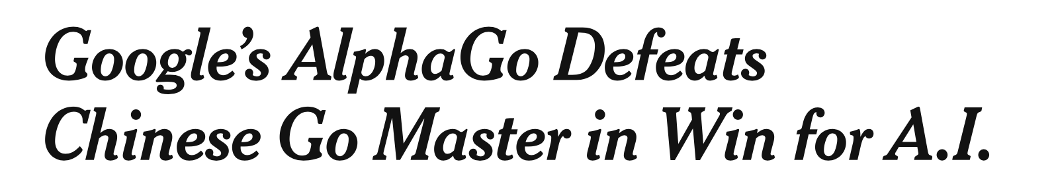

Slide 4
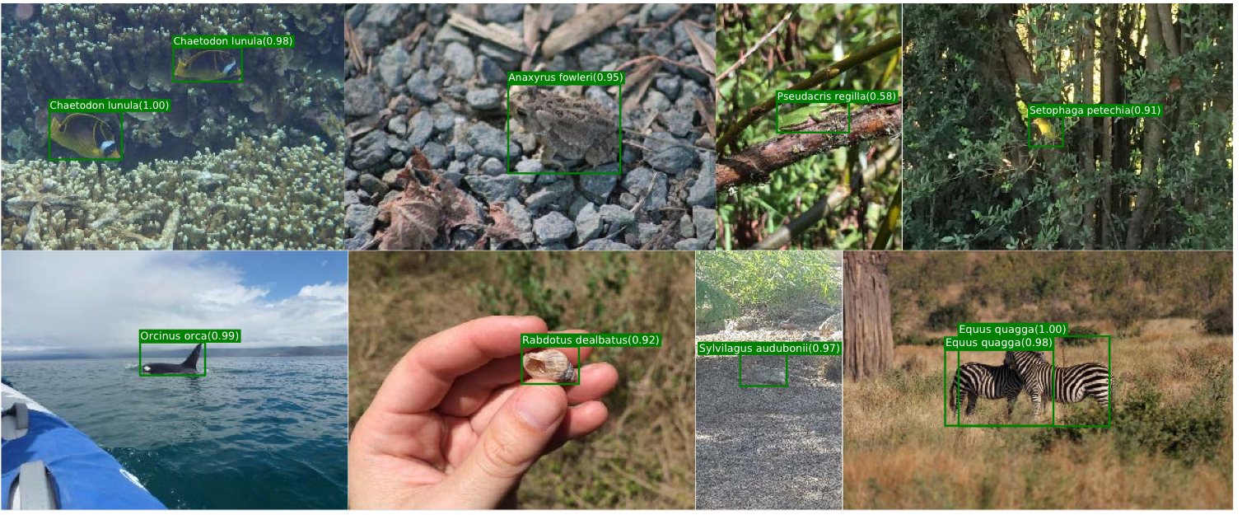

Slide 5

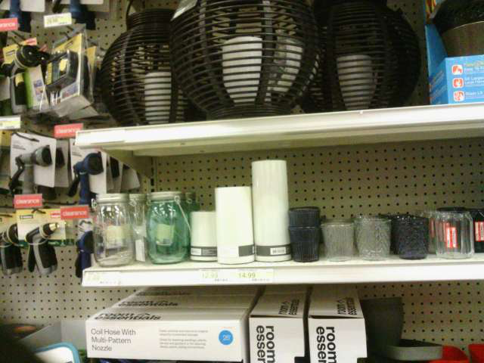
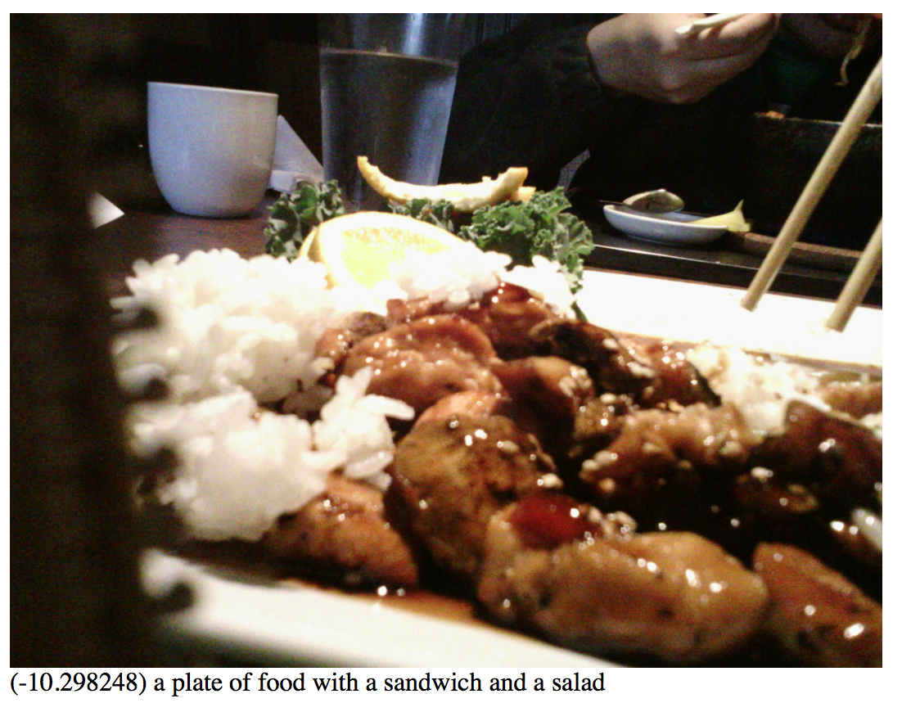
i am typing on my
laptop computer
i am shopping at a store
i am eating a plate of food with a salad and sandwich

Slide 6
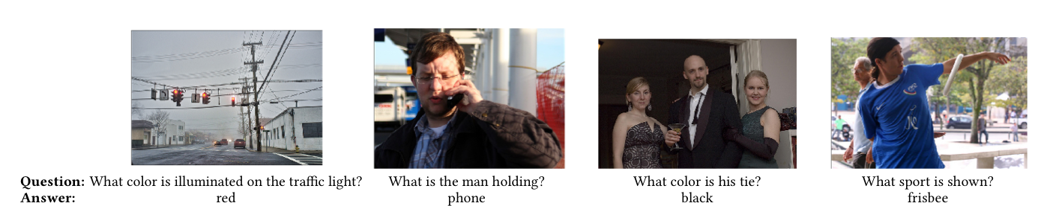
From: [Agrawal 2016], [Anderson 2017]

Slide 7



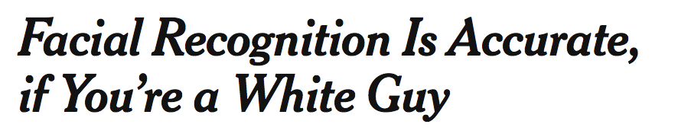



Slide 8
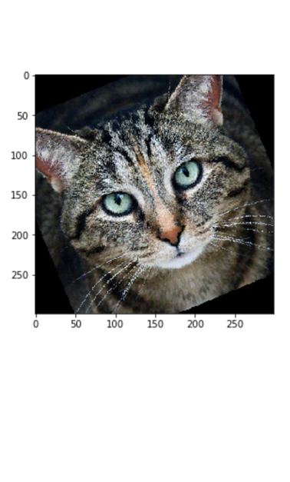
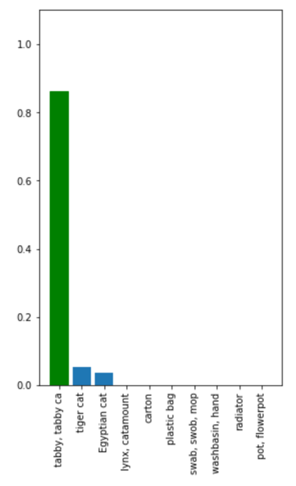
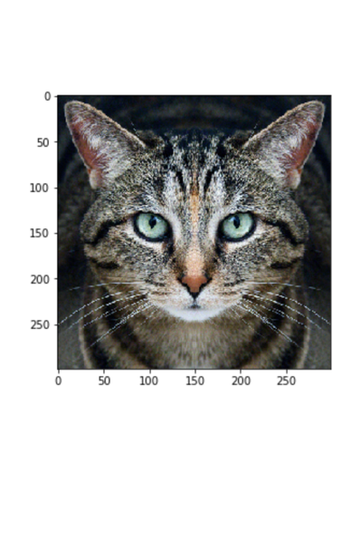
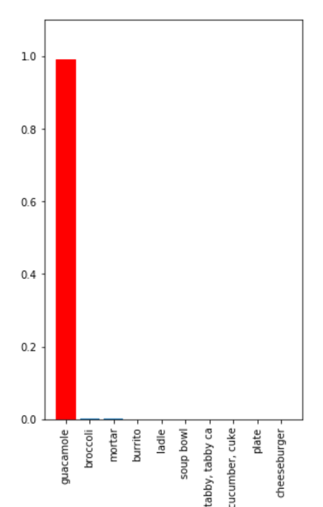
From: Labsix.org

Slide 9


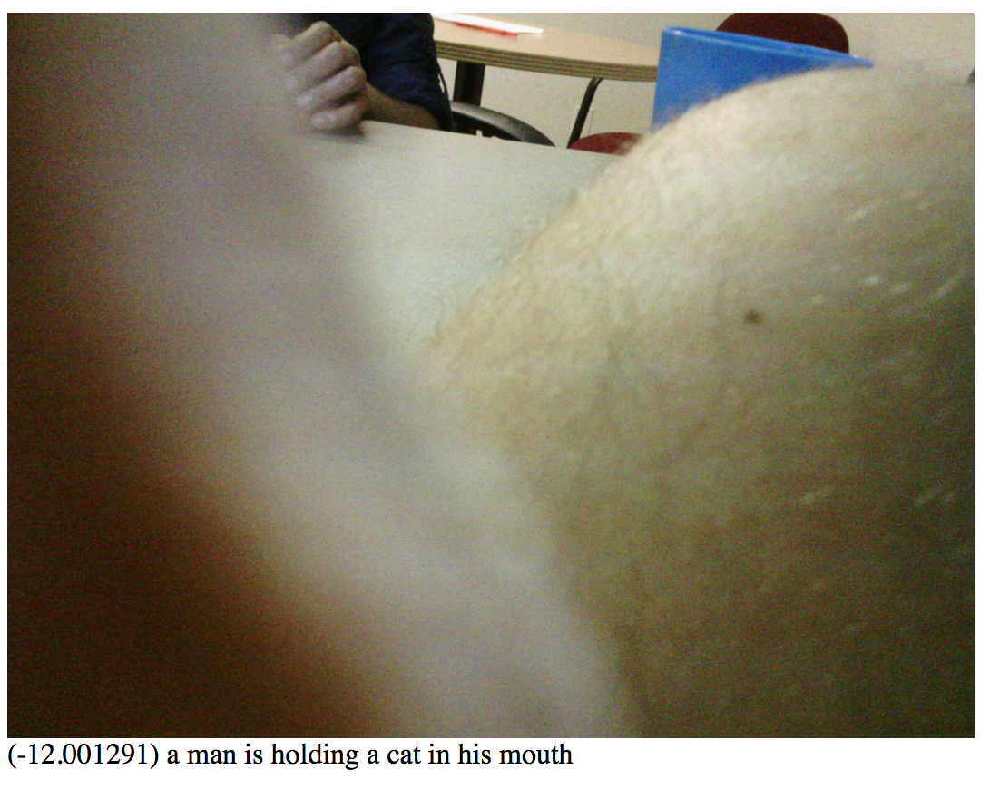
i am typing on my
laptop computer
i am shopping at a store
i am eating a plate of food with a salad and sandwich
a teddy bear is sitting on a table next to a tree and a car
a spoon and big blue bowl of fruit sitting on a table with a laptop in the background
a man is holding a cat in his mouth

Slide 10
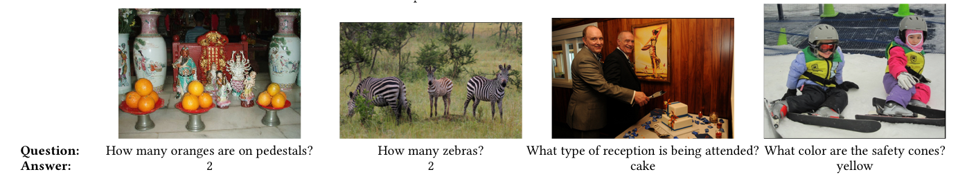
From: [Agrawal 2016], [Anderson 2017]

Slide 11
What is Artificial Intelligence?
Building machines that think like humans
have human-level intelligence
successfully perform tasks that seem to
require human-level intelligence.
Machine learning finds patterns in training data to build mathematical models of the world.

Slide 12
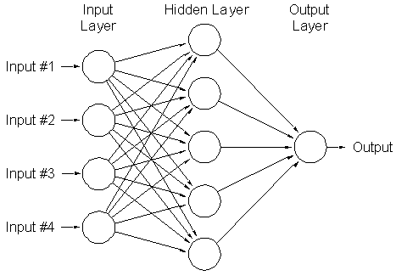
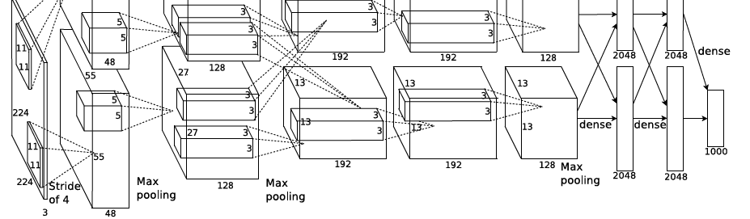
Deep Learning with Neural Networks
Neural networks: many simple
interconnected computing units.
Deep learning: neural networks with dozens of layers, millions of neurons, millions of training images.
From: Krizhevsky 2012

Slide 13
An example
Say we want to learn how to calculate the circumference of a circle from its radius.
circumference
radius

Slide 14
An example

Slide 15
An example
Which is the best model? A machine learning algorithm doesn’t know!

Slide 16
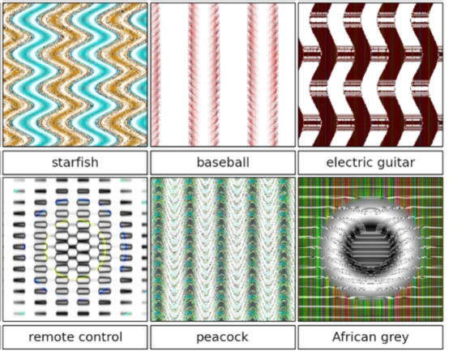
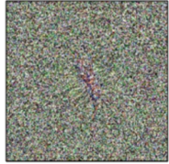
What is Machine Learning learning?
Centipede
From: Nguyen et al

Slide 17
Take aways
AI presents great opportunities and challenges for trusted systems
AI ≈ Machine learning = Fitting models to data
Computers are very good at finding patterns in data
  Even very subtle patterns that no human would identify, for better or worse.
AI is only as good as its training data
  Should be as large as possible, without bias or noise.
Rare events are unlikely to be handled correctly
  Algorithms lack sophisticated intuition that people use to solve problems they’ve never seen before.

Slide 18
When is AI successful?
Large amounts of high-quality training data
Controlled, constrained environments
Tolerance to error
Collaboration with humans
Fast, accurate processing more important than “intelligence”

Slide 19
Thanks!
For more information:
http://vision.soic.indiana.edu/
Funding: NSF CAREER, NSF SATC, IU Data to Insight Center, IU Vice Provost for Research, IU Social Sciences Research Commons, Lilly Foundation, Intel, Google, Nvidia, IARPA, AFOSR, Navy, NASA, Indiana Innovation Institute (IN3).

